Slide 1
Protocol “Layers”
Networks are complex!
many “pieces”:
  hosts
  routers
  links of various media
  applications
  protocols
  hardware, software
Question:
Is there any hope of organizing structure of network?
Or at least our discussion of networks?
1: Introduction

Slide 2
Organization of air travel
ticket (purchase)
baggage (check)
gates (load)
runway takeoff
airplane routing
ticket (complain)
baggage (claim)
gates (unload)
runway landing
airplane routing
airplane routing
a series of steps
1: Introduction

Slide 3
Organization of air travel: a different view
ticket (purchase)
baggage (check)
gates (load)
runway takeoff
airplane routing
ticket (complain)
baggage (claim)
gates (unload)
runway landing
airplane routing
airplane routing
Layers: each layer implements a service
  via its own internal-layer actions
  relying on services provided by layer below
1: Introduction

Slide 4
Layered air travel: services
Counter-to-counter delivery of person+bags
baggage-claim-to-baggage-claim delivery
people transfer: loading gate to arrival gate
runway-to-runway delivery of plane
airplane routing from source to destination
1: Introduction

Slide 5
Distributed implementation of layer functionality
ticket (purchase)
baggage (check)
gates (load)
runway takeoff
airplane routing
ticket (complain)
baggage (claim)
gates (unload)
runway landing
airplane routing
Departing airport
arriving airport
intermediate air traffic sites
airplane routing
airplane routing
airplane routing
1: Introduction

Slide 6






Next example
Luton, Anh quốc
Trại giam T16
Chuyển thông điệp
“I lov u” cho TH
Mai Phương
Thị Huyền
Tiến thứ trưởng gửi cô
thông điệp “I lov u”
From : Tiến thứ trưởng,
Trại giam T16
To : Hoa hậu MP, Luton
“I lov u”
Bưu cục Hà Tây
Bưu cục Luton
Bưu cục Hà Nội
Bưu cục London
1: Introduction

Slide 7
Why layering?
Dealing with complex systems:
explicit structure allows identification, relationship of complex system’s pieces
  layered reference model for discussion
modularization eases maintenance, updating of system
  change of implementation of layer’s service transparent to rest of system
  e.g., change in gate procedure doesn’t affect rest of system
layering considered harmful?
1: Introduction

Slide 8
Internet protocol stack
application: supporting network applications
  ftp, smtp, http
transport: process-to-process data transfer
  tcp, udp
network: routing of datagrams from source to destination
  ip, routing protocols
link: data transfer between neighboring network elements
  ppp, ethernet
physical: bits “on the wire”
application
transport
network
link
physical
1: Introduction

Slide 9


Layering: logical communication
Each layer:
distributed
“entities” implement layer functions at each node
entities perform actions, exchange messages with peers
application
transport
network
link
physical
network
link
physical
application
transport
network
link
physical
application
transport
network
link
physical
application
transport
network
link
physical
1: Introduction

Slide 10
Layering: logical communication
data
E.g.: transport
take data from app
add addressing, reliability check info to form “datagram”
send datagram to peer
wait for peer to ack receipt
analogy: post office
application
transport
network
link
physical
transport
ack
network
link
physical
application
transport
network
link
physical
data
data
application
transport
network
link
physical
application
transport
network
link
physical
transport
1: Introduction

Slide 11
Layering: physical communication
data
application
transport
network
link
physical
network
link
physical
application
transport
network
link
physical
data
application
transport
network
link
physical
application
transport
network
link
physical
1: Introduction

Slide 12
Protocol layering and data
Each layer takes data from above
adds header information to create new data unit
passes new data unit to layer below
source
destination
M
application
transport
network
link
physical
application
transport
network
link
physical
M
message
H
M
H
t
M
segment
t
H
H
H
H
M
datagram
n
t
M
n
t
H
H
H
H
H
H
M
frame
l
n
t
M
l
n
t
1: Introduction

Slide 13
Internet structure: network of networks
roughly hierarchical
national/international backbone providers (NBPs)
  e.g. BBN/GTE, Sprint, AT&T, IBM, UUNet
  interconnect (peer) with each other privately, or at public Network Access Point (NAPs)
regional ISPs
  connect into NBPs
local ISP, company
  connect into regional ISPs
local
ISP
regional ISP
NBP B
NAP
NAP
NBP A
regional ISP
local
ISP
1: Introduction

Slide 14
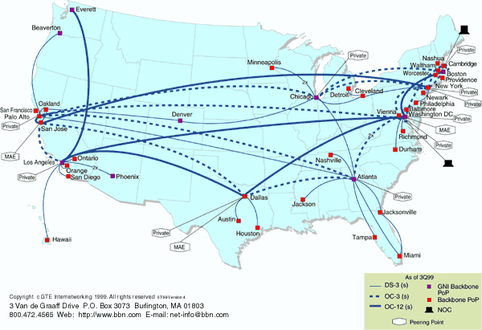
National Backbone Provider
e.g. BBN/GTE US backbone network
1: Introduction

Slide 15
Internet History
1961-1972: Early packet-switching principles
1961: Kleinrock - queueing theory shows effectiveness of packet-switching
1964: Baran - packet-switching in military nets
1967: ARPAnet conceived by Advanced Reearch Projects Agency
1969: first ARPAnet node operational
1972:
  ARPAnet demonstrated publicly
  NCP (Network Control Protocol) first host-host protocol
  first e-mail program
  ARPAnet has 15 nodes
1: Introduction

Slide 16
Internet History
1972-1980: Internetworking, new and proprietary nets
1970: ALOHAnet satellite network in Hawaii
1973: Metcalfe’s PhD thesis proposes Ethernet
1974: Cerf and Kahn - architecture for interconnecting networks
late70’s: proprietary architectures: DECnet, SNA, XNA
late 70’s: switching fixed length packets (ATM precursor)
1979: ARPAnet has 200 nodes
Cerf and Kahn’s internetworking principles:
  minimalism, autonomy - no internal changes required to interconnect networks
  best effort service model
  stateless routers
  decentralized control
define today’s Internet architecture
1: Introduction

Slide 17
Internet History
1980-1990: new protocols, a proliferation of networks
1983: deployment of TCP/IP
1982: smtp e-mail protocol defined
1983: DNS defined for name-to-IP-address translation
1985: ftp protocol defined
1988: TCP congestion control
new national networks: Csnet, BITnet, NSFnet, Minitel
100,000 hosts connected to confederation of networks
1: Introduction

Slide 18
Internet History
1990’s: commercialization, the WWW
Early 1990’s: ARPAnet decomissioned
1991: NSF lifts restrictions on commercial use of NSFnet (decommissioned, 1995)
early 1990s: WWW
  hypertext [Bush 1945, Nelson 1960’s]
  HTML, http: Berners-Lee
  1994: Mosaic, later Netscape
  late 1990’s: commercialization of the WWW
Late 1990’s:
est. 50 million computers on Internet
est. 100 million+ users
backbone links runnning at 1 Gbps
1: Introduction

Slide 19
Chapter 1: Summary
Covered a “ton” of material!
Internet overview
what’s a protocol?
network edge, core, access network
performance: loss, delay
layering and service models
backbones, NAPs, ISPs
history
ATM network
You now hopefully have:
context, overview, “feel” of networking
more depth, detail later in course
1: Introduction

